Slide 1
Автор: Наговицына Оксана, ученица 5 «А» класса
Руководитель: Никитина В.И.
Муниципальное общеобразовательное учреждение средняя общеобразовательная школа № 2 г. Нижние Серги
.
Welcome to London Parks

Slide 2
The aim: to have a virtual excursion about London parks
The objects:
to find necessary information;
to analyze the information;
to prepare a presentation on this topic;
to present the work to the public.

Slide 3
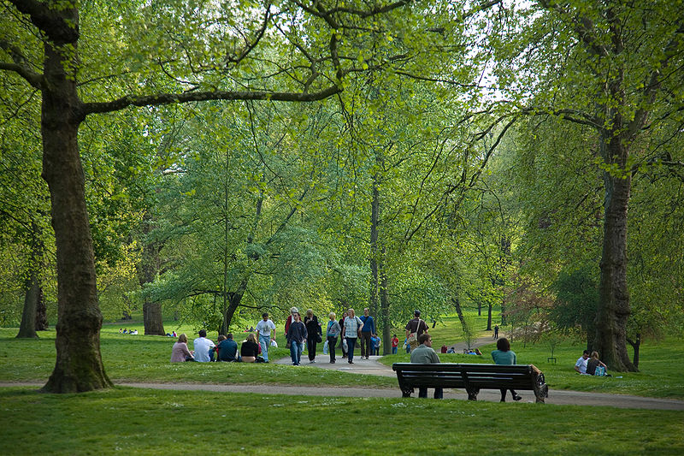
London is the capital of the United Kingdom of Great Britain and Northern Ireland. It is the greenest city in the world. The territory of parks and gardens equals 11% of the territory of the city. There are about 1700 parks and gardens in London.

Slide 4
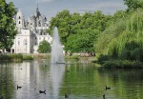
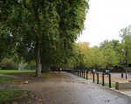
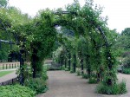
Five of nine Royal parks are situated in the heart of the city. The most famous are Saint James‘s park, Green Park, Hyde park and Kensington Gardens. Each is unique and beautiful.

Slide 5
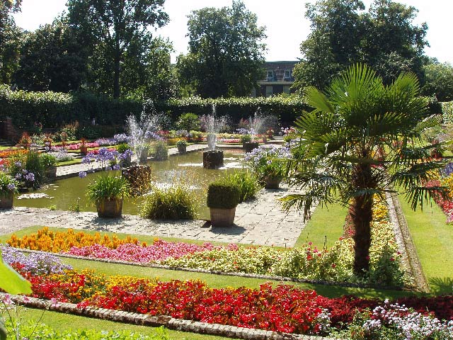
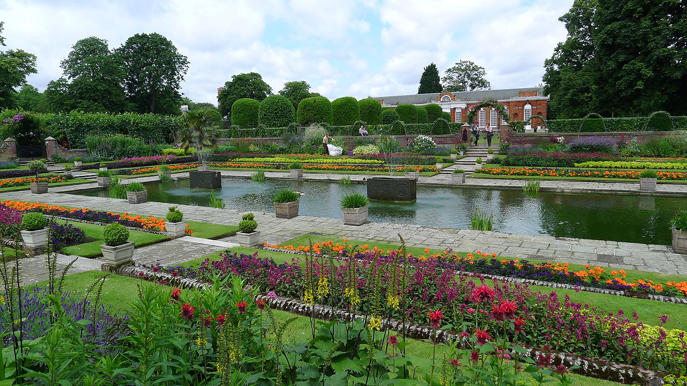
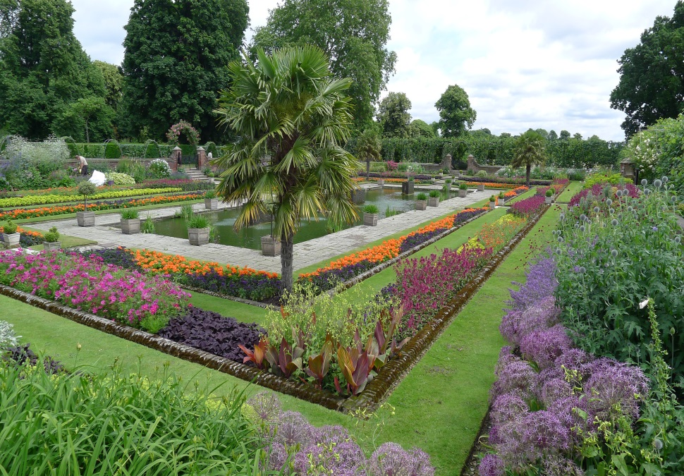
Kensington Gardens. Its area is more than one square kilometer.

Slide 6
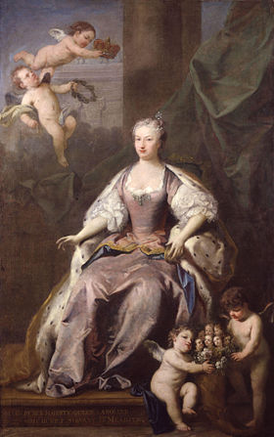
Kensington Gardens
was opened to the public
by the queen Caroline of
Brandenburg-ansbach in 1728

Slide 7
The statue of
Peter Pan
is one of its attractions

Slide 8
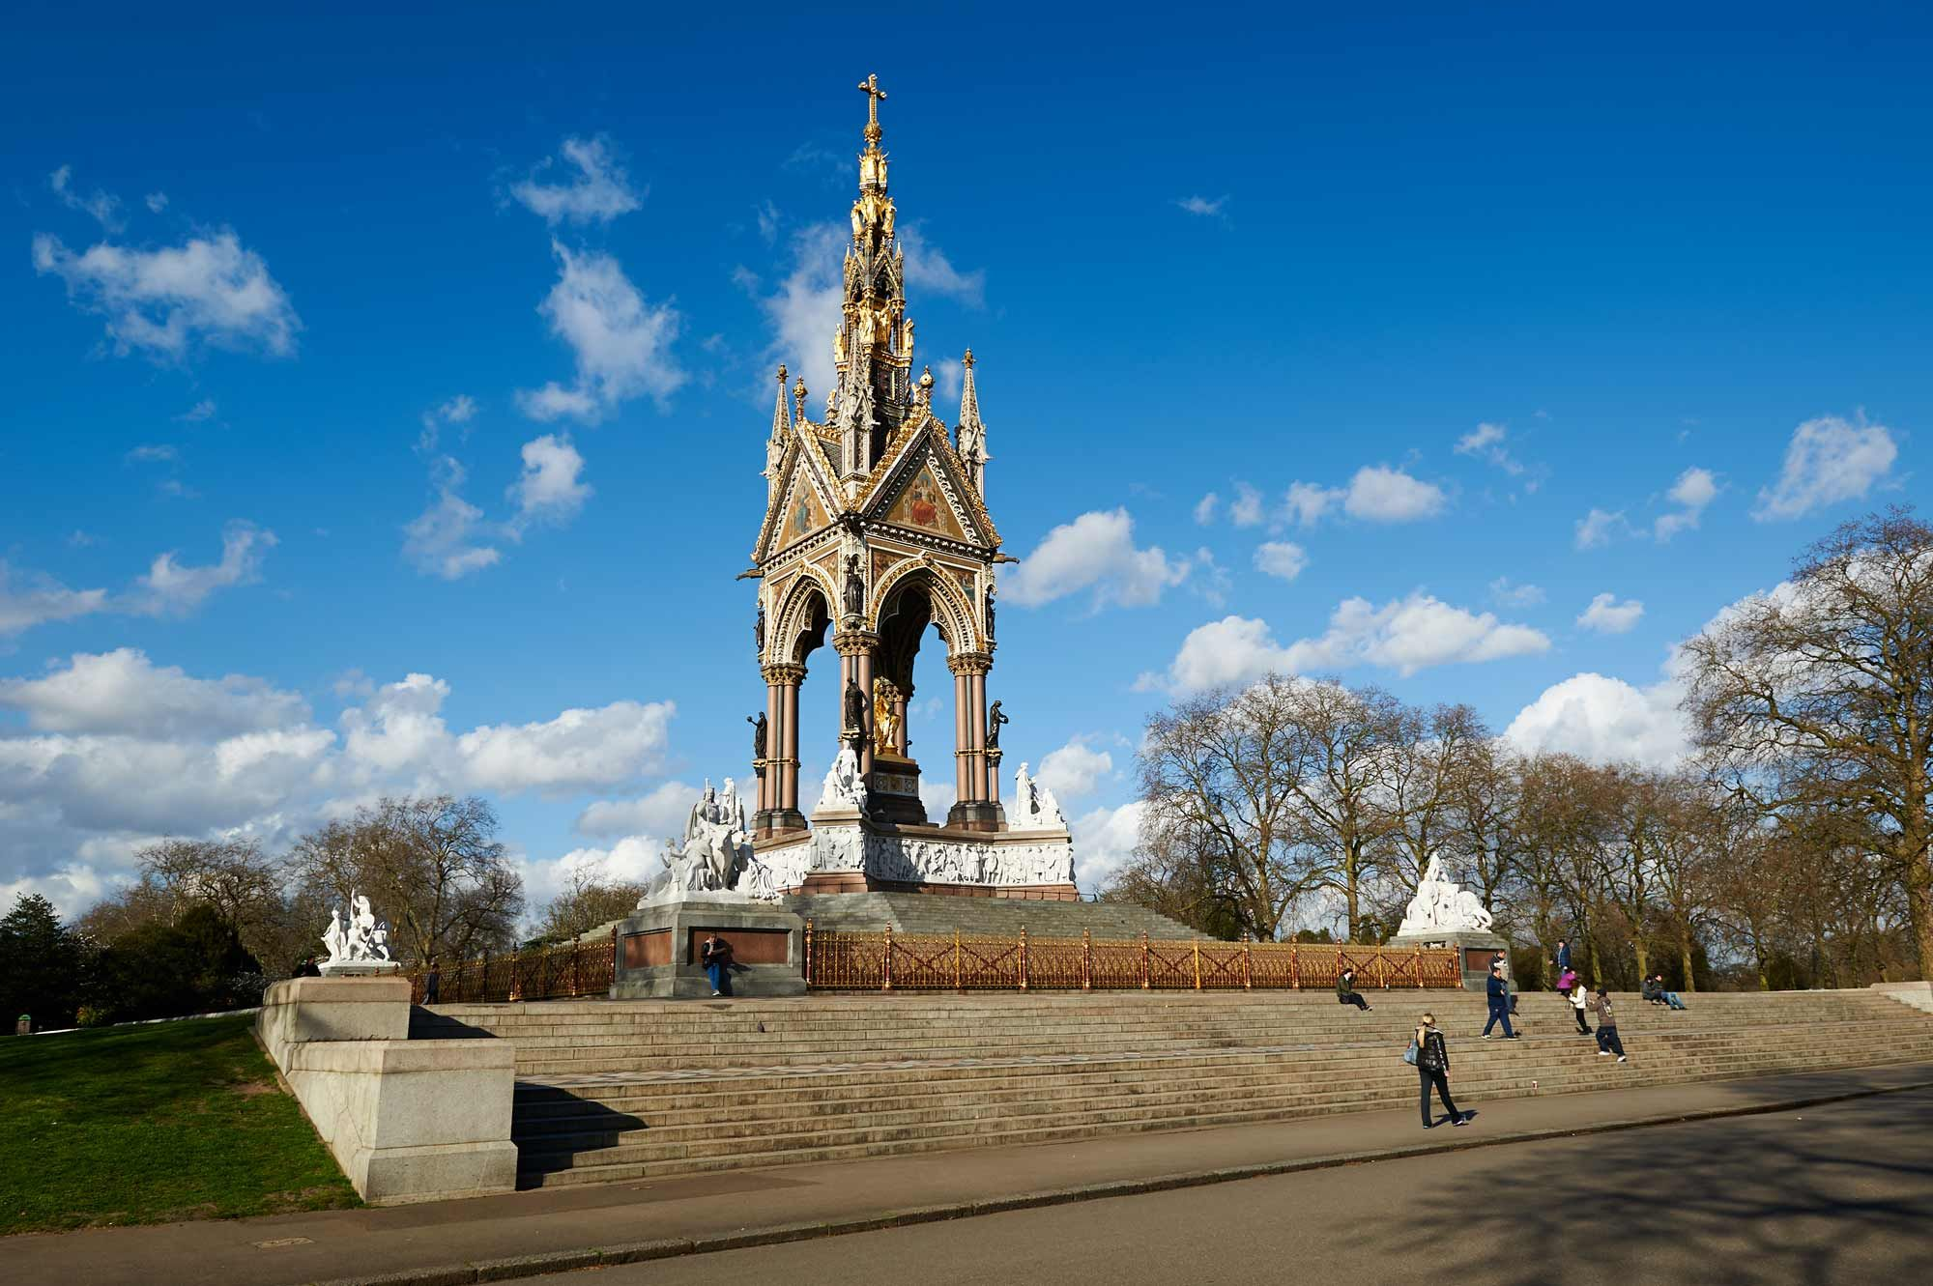
The Albert Memorial in Kensington Gardens is one of London's most ornate monuments. It commemorates the death of Prince Albert in 1861 of typhoid.

Slide 9
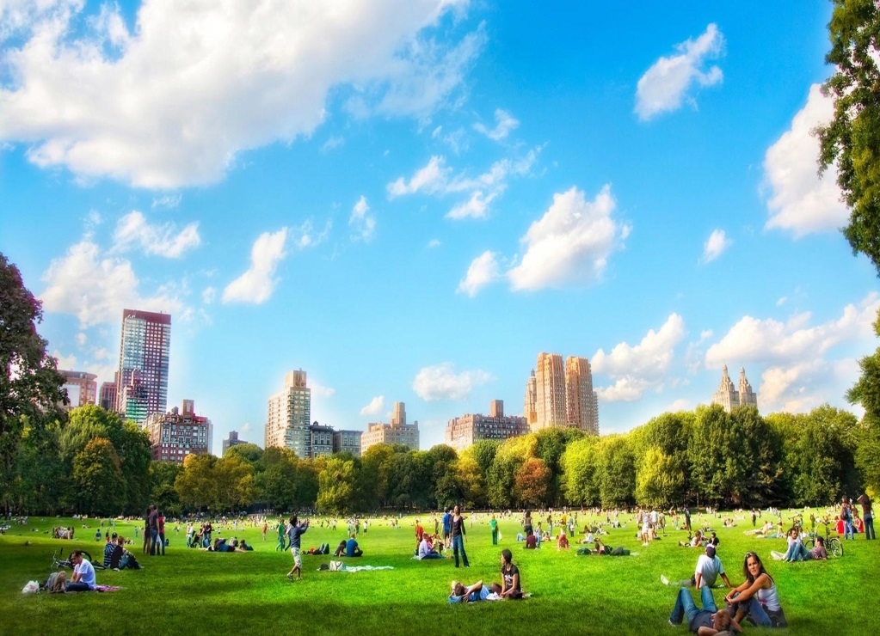
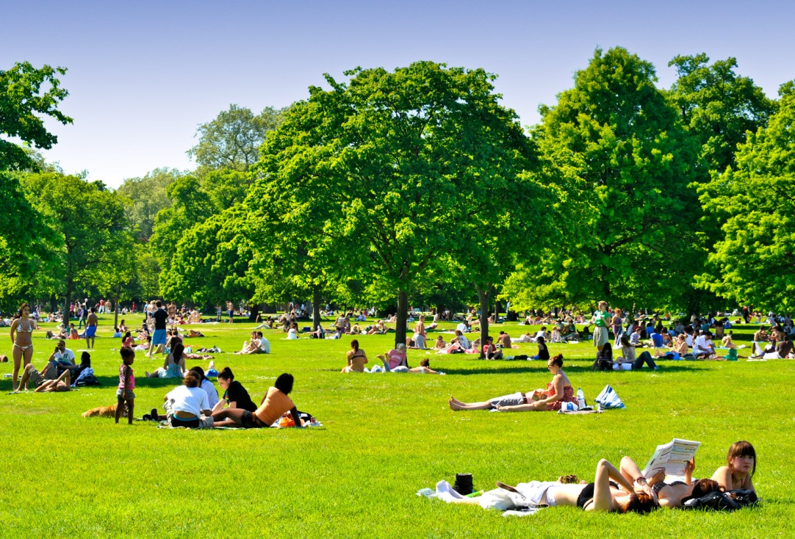
Hyde Park
is one of the largest parks in central London. It was founded during Henry VIII reign. It attracts thousand of tourists of different age because of vast range of entertainments.

Slide 10
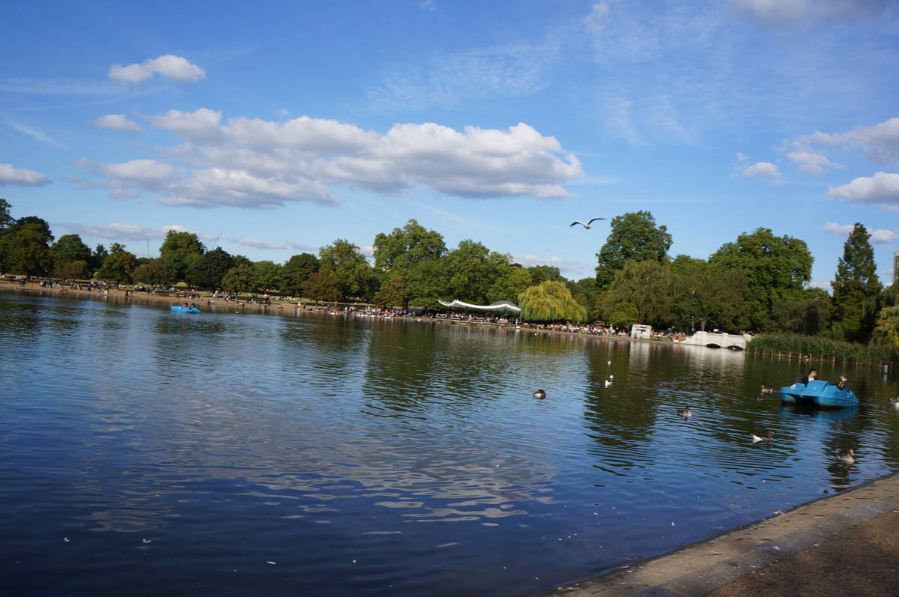
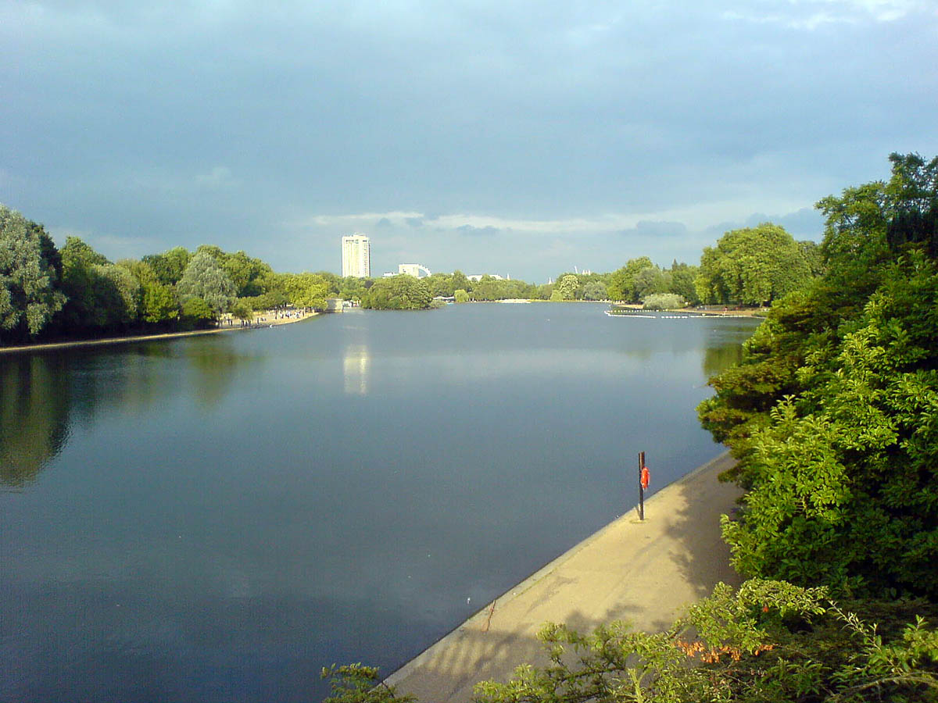
Lake Serpentine is very beautiful and everyone can swim here.

Slide 11
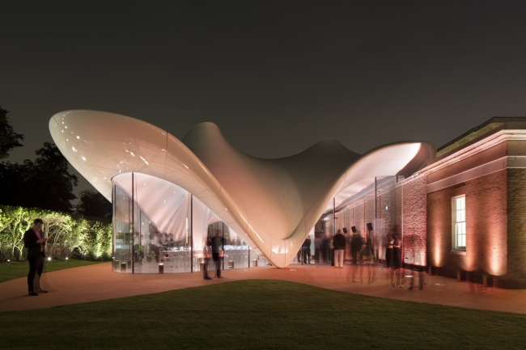
The Serpentine Sackler Gallery is one of attractions

Slide 12
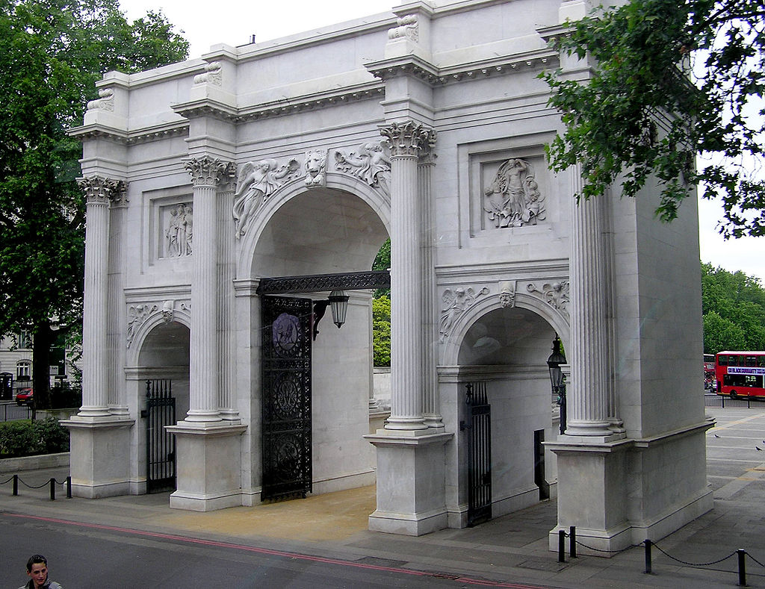
Marble Arch used to situate near the Buckingham Palace which is the London residence and principal workplace of the reigning monarch of the United Kingdom.

Slide 13
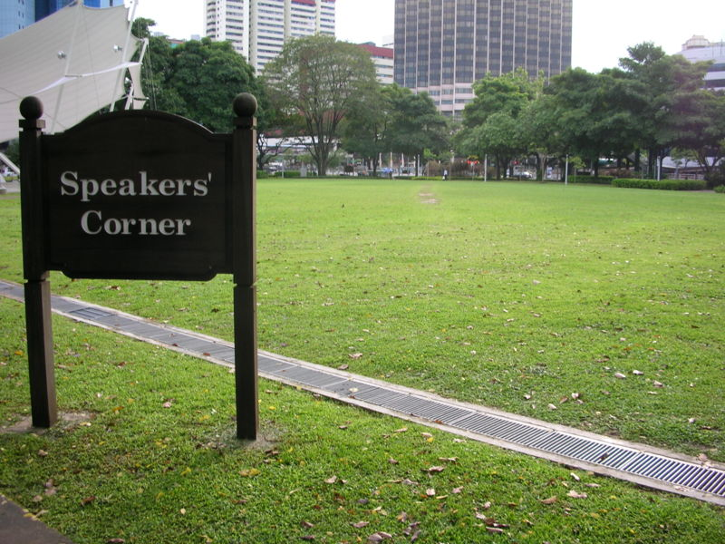
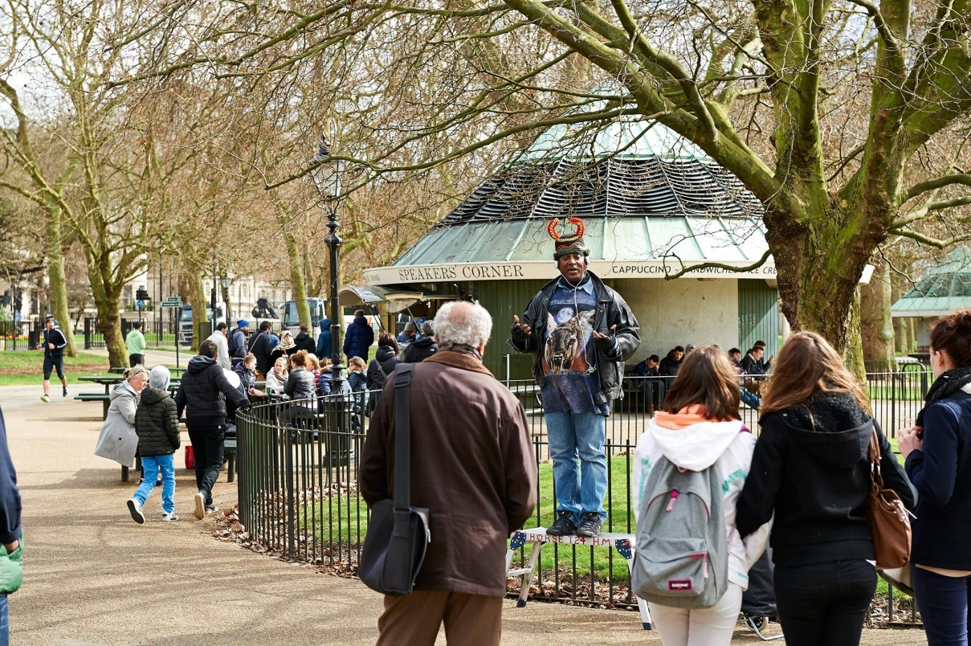
It is also famous for its Speakers’ Corner which is a traditional site for public speeches and debates since the mid 1800's when protests and demonstrations took place in Hyde Park
.

Slide 14
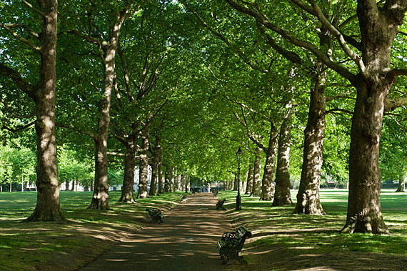
Green Park is situated between St James’s Park and Hyde Park. It is a very quiet green place.

Slide 15
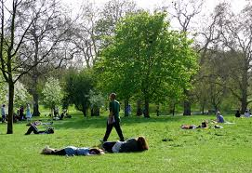
Londoners like doing sports or relaxing

Slide 16
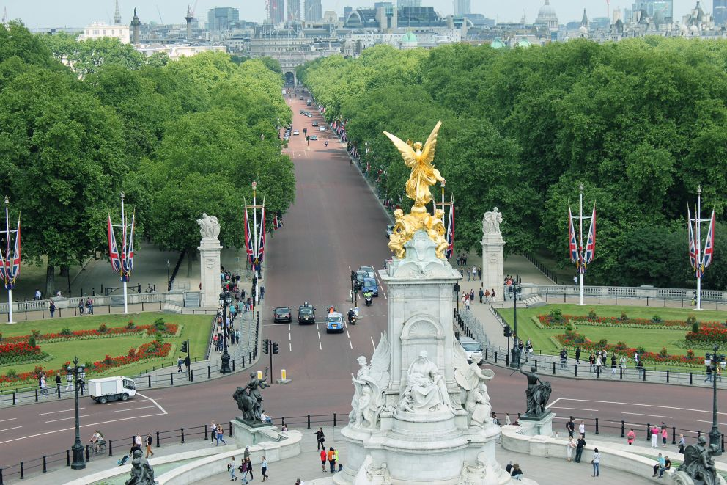
Victoria Memorial

Slide 17
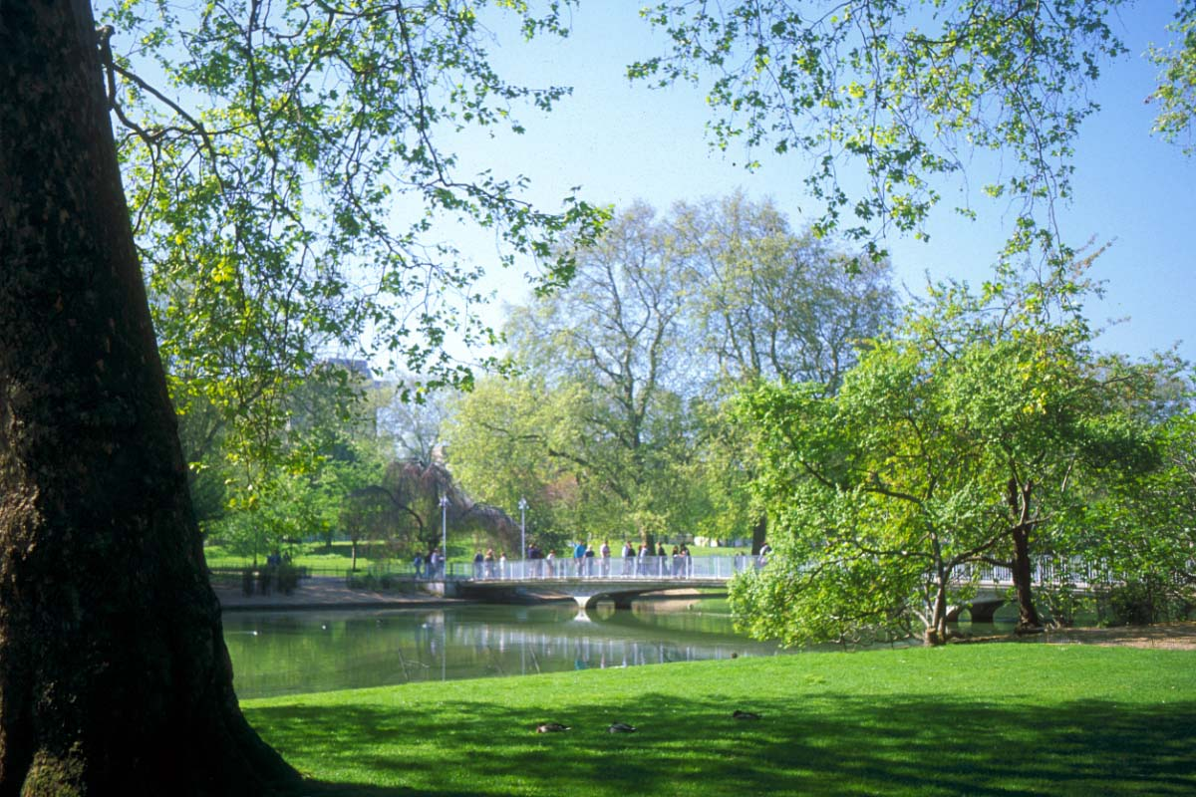
Saint James’s Park is a 23 hectares park in the City of Westminster, central London.

Slide 18
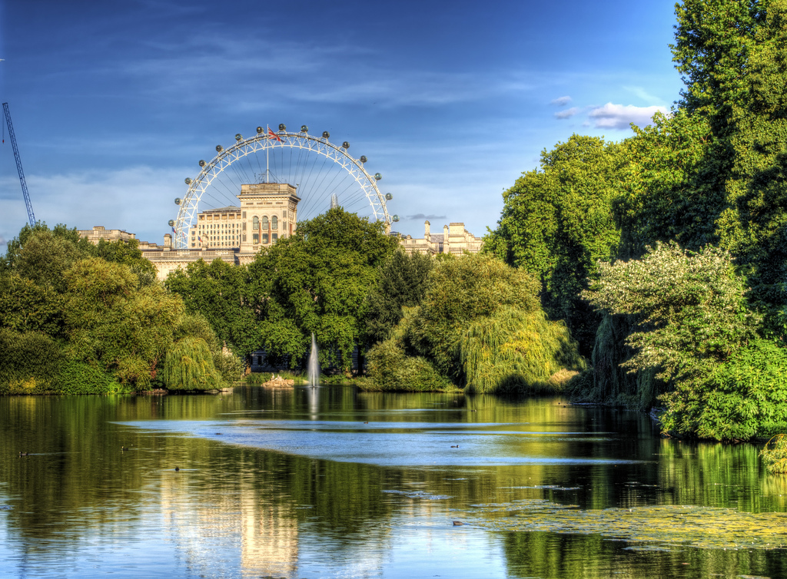
The park is bounded by Buckingham Palace to the west

Slide 19
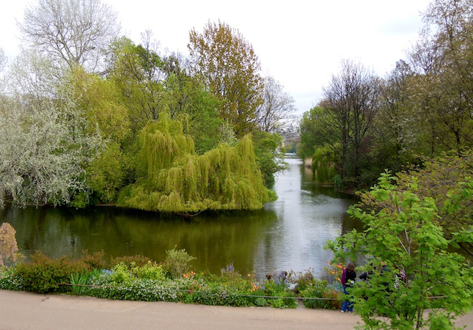
The park has a small lake, St. James's Park Lake, with two islands.

Slide 20
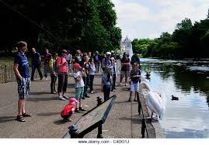
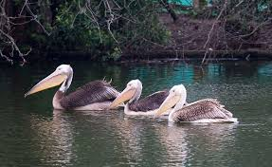
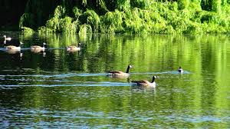
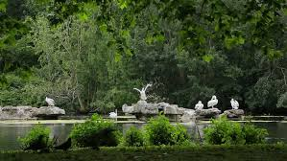
Two islands are West Island, and Duck Island, which is named for the lake's collection of waterfowl. This includes a resident colony of pelicans, which has been a feature of the park since the first gift of the birds from a Russian ambassador in 1664.

Slide 21
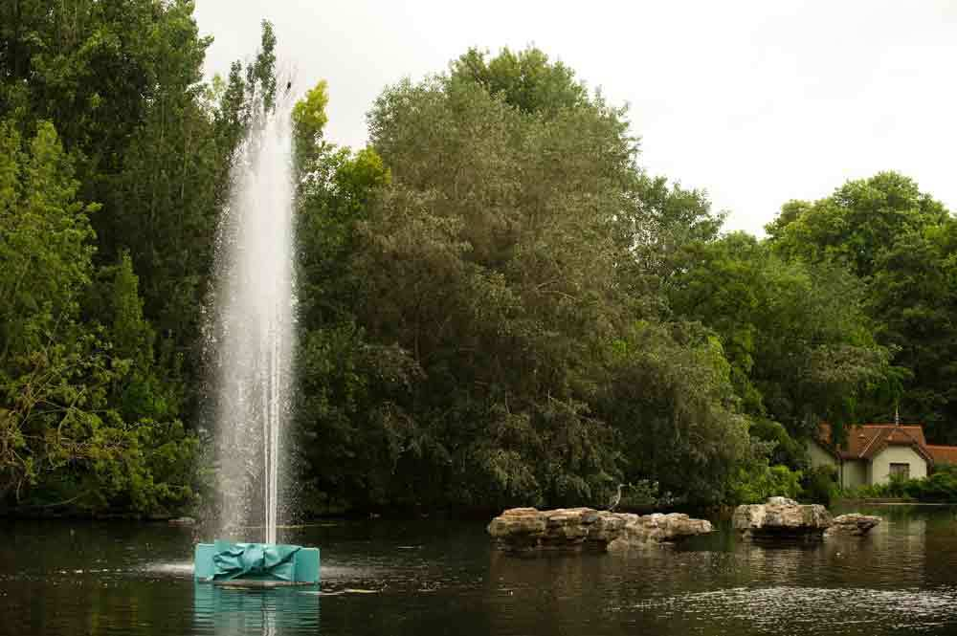
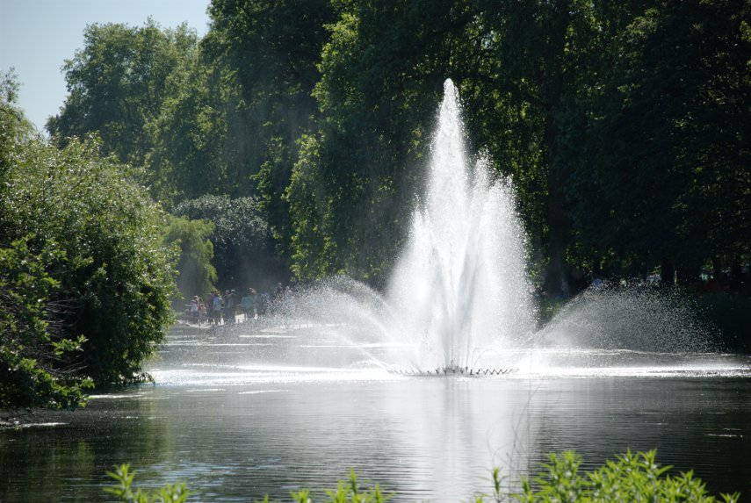
The Tiffany fountain is situated on Pelican Rock

Slide 22
Conclusion.
After my researches I realize that
London is a wonderful place
where everybody can relax,
have a nice time, swim and
admire beautiful sights.

Slide 23
Ресурсы:
Англия: История и современность. Халилова Л. М.: Рольф, 1999.
Лингвострановедческая копилка. Володина С.В. ОАО «Альянс», 2013.
Международная мировая энциклопедия.
Интернет-ресурсы.

Slide 24
Thank you very much
for your attention

